Slide 1
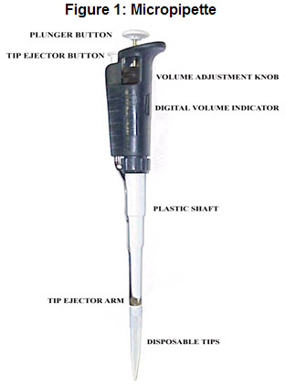
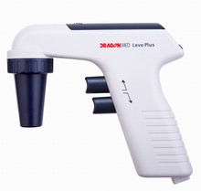
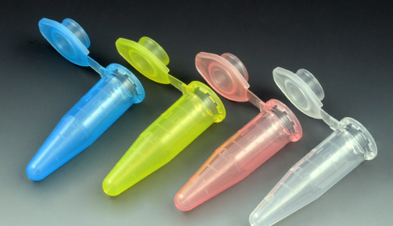
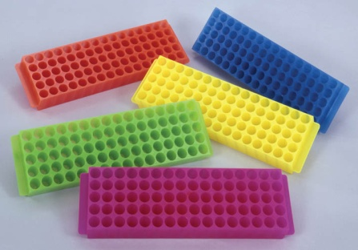
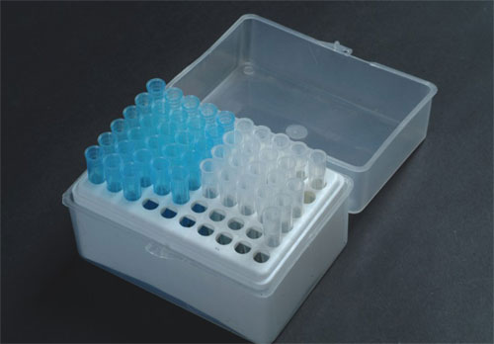
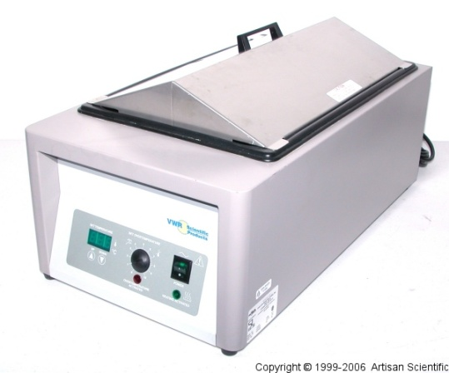
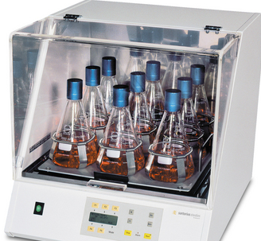
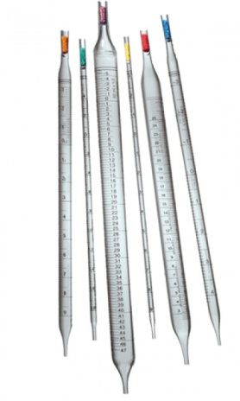
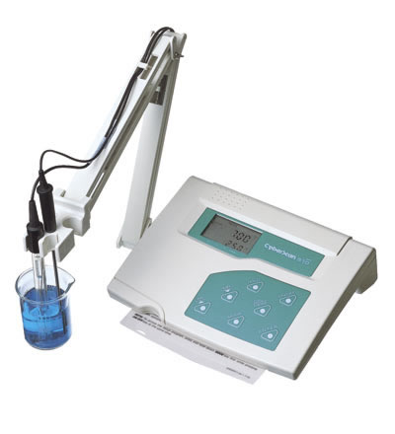
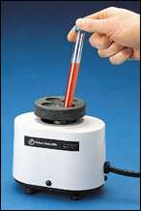
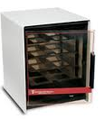
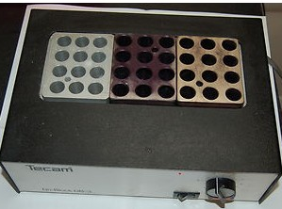
10. Where are the racks for microcentrifuge tubes? _____________________________ 11. What about racks for bigger tubes? Where are those?_____________________
Names______________________________________ Date _________
1. How many micropipettes do you see on your bench? ________________
2. Where can you find pipette tips if I run out of those on my bench? __________________________________
3. Where do I find microcentrifuge tubes?__________
4. How many bench top centrifuges are found in
this classroom?_______________________________
5. Where is the closest microcentrifuge?________________
6. How many heat blocks are in 351?_______________
7. Where are the pipette aids?__________
_________________________________
8. What sizes of serologic pipettes do we have?_______ ____
9. Where do I find more of them?_______________________
12. How many sinks are in this class room? ________________________
13. Where is the biohazard trash in this room?______________________
14. Where are the regular trash containers? ________________________
15. Where is the emergency shower? ______________________________
16. Where is the emergency eye wash station?____________________
17. Where is the spill kit?___________________________________
18. Where are the water baths? ________________________________
19. How many are there?___________________________________
20. Where are the incubators?____________________________
21. How many of them do we have?_______________________
22. Where is the -20 freezer? ___________________________
23. Where is the fridge?________________________________
24. Where are the gloves?________________________________
25. Where are the nearest vortexer?______________________________
26. How many do we have?____________________
27. Where do I spin 15 mL tubes?______________________________
28. Where are the rotary shakers?______________________________
29. Where is the UV transilluminator?___________________________
30. where is the pH meter?___________________________________

Slide 2
Map of 351

